Slide 1



PJVelasco Data 1 Apocolypse Food Prep
View in Power BI
Last data refresh:
17/04/2025 3:48:16 pm UTC
Downloaded at:
18/04/2025 12:15:59 am UTC

Slide 2
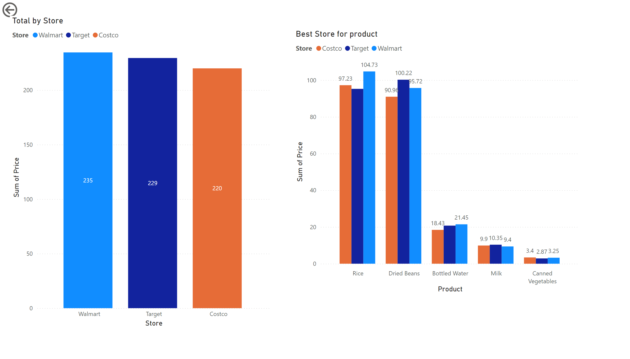
Page 1
Notes:
actionButton
No alt text provided
Total by Store
No alt text provided
Best Store for product
No alt text provided

